Slide 1
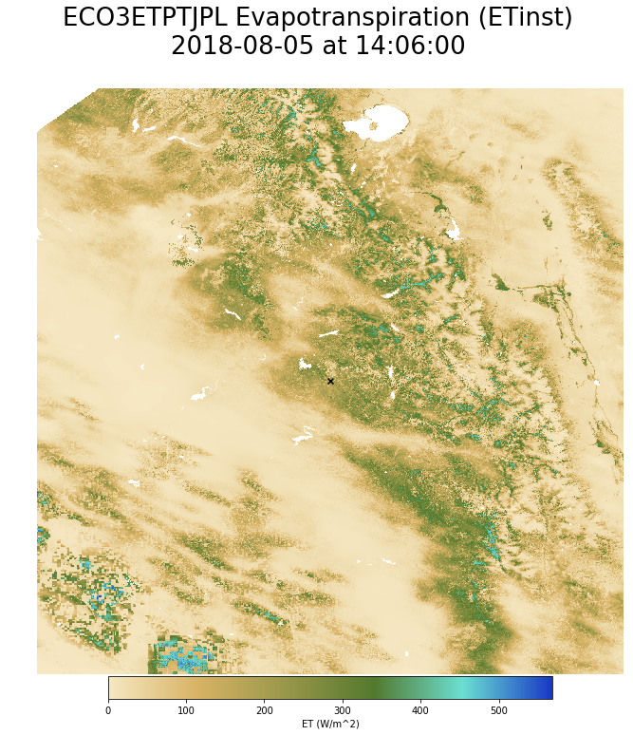
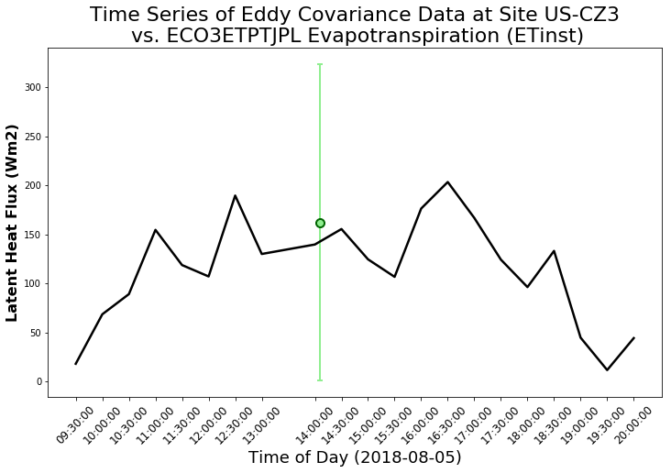
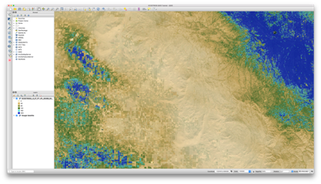
Hands-on Workshop for Accessing, Processing, and Analyzing ECOSTRESS Data
Thursday, March 21, 2019
Cole Krehbiel
LP DAAC Remote Sensing Scientist
Innovate!, Inc., contractor to USGS EROS
Sioux Falls, South Dakota
*Work performed under USGS contract G15PD00766
Gregory Halverson and Christine Lee
Jet Propulsion Laboratory, California Institute of Technology, Pasadena, CA, USA
U.S. Department of the Interior
U.S. Geological Survey

Slide 2
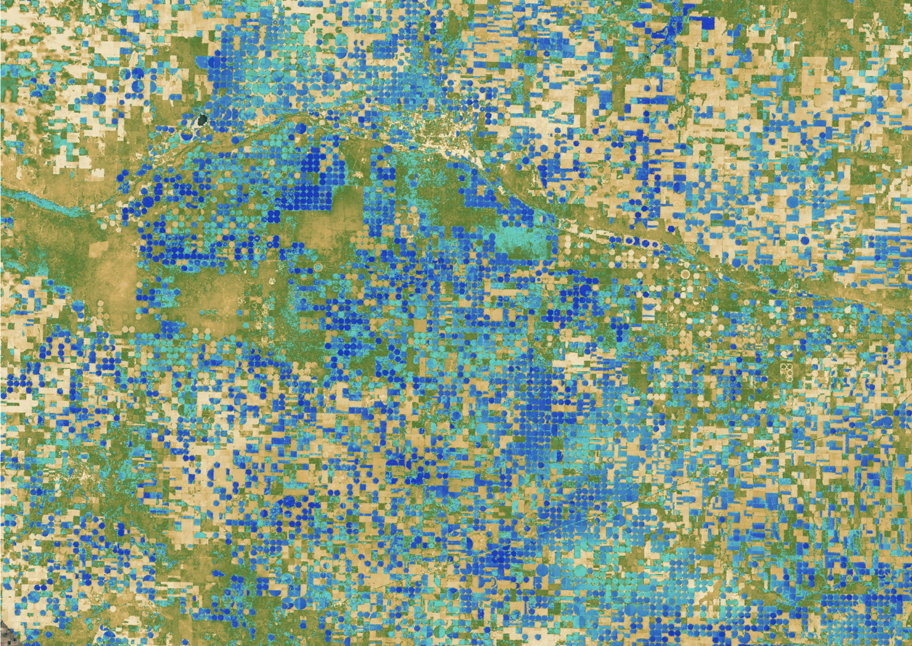
Workshop Session 1
Introductions
Pre-workshop Instructions
Search and Download ECOSTRESS Data Using Earthdata Search Client
How to use the ECOSTRESS Swath to Grid Conversion Python Script
Working with ECOSTRESS Evapotranspiration Data in Python Tutorial Part 1
Break
Workshop Session 2
Working with ECOSTRESS Evapotranspiration Data in Python Tutorial Part 2
Techniques for Visualizing ECOSTRESS Data in QGIS
Making Maps in QGIS

Slide 3
Workshop Session 2
Working with ECOSTRESS Evapotranspiration Data in Python Tutorial Part 2
Techniques for Visualizing ECOSTRESS Data in QGIS
Making Maps in QGIS

